Slide 1
͢
Level sets of L(β)
v
-∇L(β)
-∇L(β)
β₂
-∇L(β)c
β₁

Slide 2
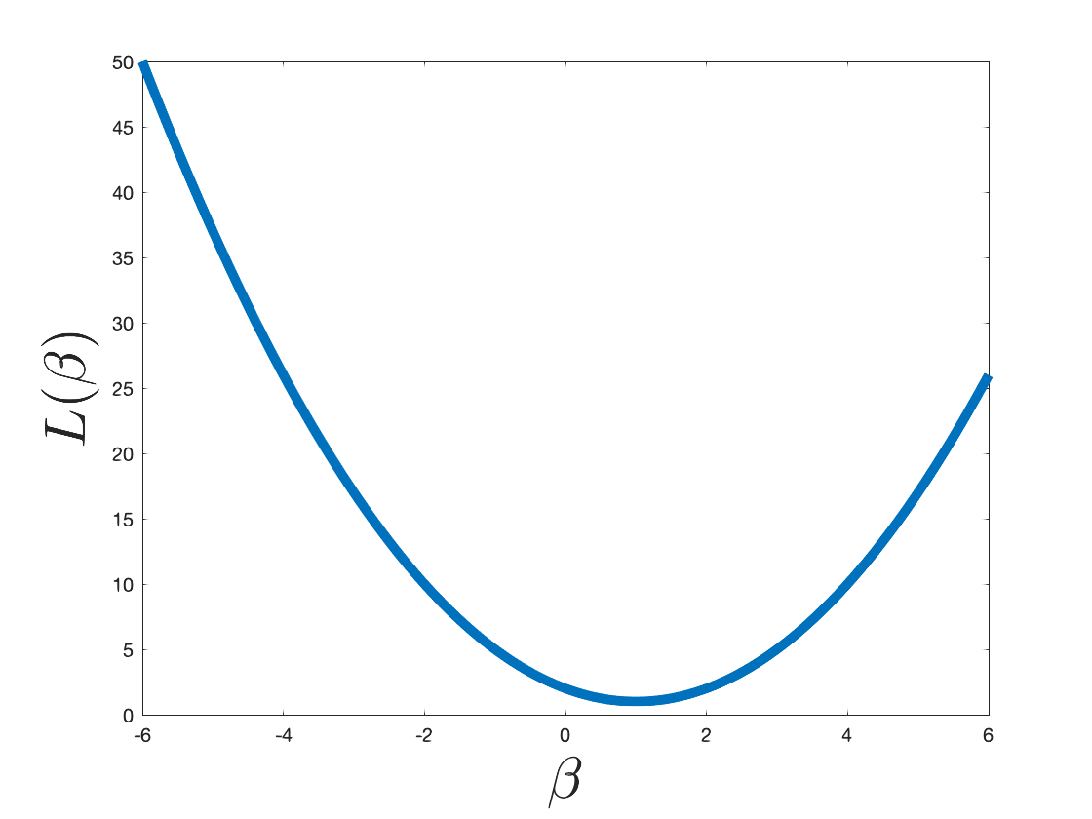
L(β₂)
L(β₁)
β₁
β₂

Slide 3
d features
1
1
...
n examples
...
age
BMI
sex
1
X

Slide 4
y
x

Slide 5
x
✓
✓

Slide 6
This is a sentence.
1
1
1
1
a
aardvark
zyzzyva
zoo

Slide 7
This is a sentence.
1
1
1
“a sentence”
“is a”
“this is”

Slide 8
This is a sentence.
1
1
“is a sentence”
“this is a”

Slide 9
feature extraction
ML
prediction
1
0
1
1
1
0
0
0
0
0
0
1
1
1
0
0 (safe)
1
0
0
0
1
0
1
0
0
1
0
0
0
0
0
1 (spam)
1
0
0
0
0
1
1
1
0
0
0
0
0
0
0
0 (safe)
1
0
0
0
0
1
0
0
1
0
1
0
0
0
0
0 (safe)
1
0
0
0
1
0
1
0
1
0
0
1
1
0
0
1 (spam)

Slide 10
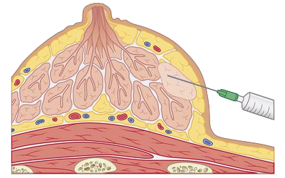
breast lump
syringe/needle
cross section

Slide 11
class 1
class 2
class 3
q classifiers to learn

Slide 12
class 1
class 2
class 3
O(q²) classifiers to learn.

Slide 14
⟨β, x⟩ > 0
β
seperating hyperplane
⟨β, x⟩ < 0
⟨β, x⟩ = 0

Slide 16
support vectors
β
β
m
m

Slide 18

β
$$\frac{\text{ε}\text{i}}{\text{∥}\text{β}\text{∥}}$$
1/∥β∥

Slide 19
β
support vectors
$$\frac{\text{ε}\text{i}}{\text{∥}\text{β}\text{∥}}$$
1/∥β∥

Slide 21

support vectors
$$\frac{\text{ε}\text{i}}{\text{∥}\text{β}\text{∥}}$$
large C
smaller C

Slide 22
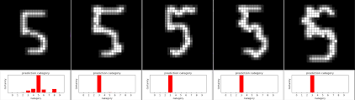
matrix matx
vecx = matx.ravel()
vector vecx
28
1
784
matx = vecx.reshape((28,28))
28
⟶
⟶
x
⟶
x
w
θ
θ
⟶
w

Slide 23
⟶
x
⟶
w

Slide 24
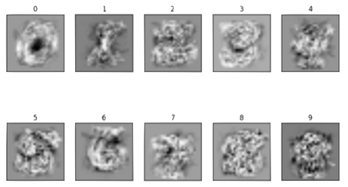
⟶
⟶
β₀
x_{new}
⟨
⟩
= 45
,
⟶
⟶
β₅
x_{new}
⟨
⟩
= 212
,
⟶
⟶
β₆
x_{new}
⟨
⟩
= 84
,

Slide 25
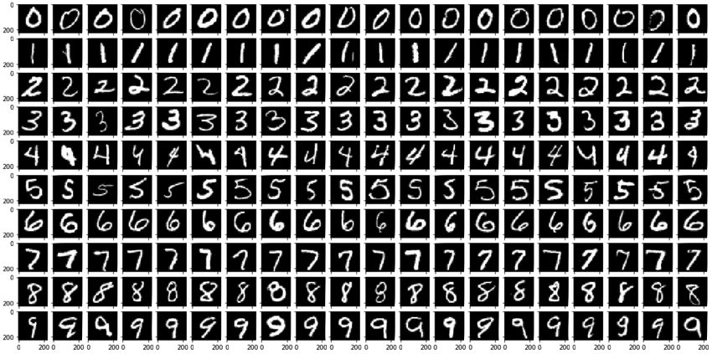
⟶
⟶
⟶
⟶
⟶
⟶
x₁
x₂
x₃
x₄
x₅
x₆
...
...
⟶
⟶
⟶
⟶
⟶
⟶
𝛼₀[1] = .4
𝛼₀[2] = .9
𝛼₀[3] = .2
𝛼₀[4] = .1
𝛼₀[5] = .8
𝛼₀[6] = .05
...
⟶
⟶
⟶
⟶
⟶
⟶
𝛼₁[1] = .05
𝛼₁[2] = .1
𝛼₁[3] = .2
𝛼₁[4] = .02
𝛼₁[5] = .1
𝛼₁[6] = .95
...
...
...
...
...
...
...
⟶
⟶
⟶
⟶
⟶
⟶
𝛼₅[1] = .1
𝛼₅[2] = .2
𝛼₅[3] = .85
𝛼₅[4] = .75
𝛼₅[5] = .1
𝛼₅[6] = .05
...
...
...
...
...
...

Slide 26
⟶
⟶
⟶
⟶
⟶
⟶
x₁
x_{new}
x₂
x_{new}
X₃
x_{new}
⟨
⟩
⟨
⟩
⟨
⟩
= 45
+
+
+
⟶
⟶
⟶
𝛼₀[1] ×
𝛼₀[2] ×
𝛼₀[3] ×
...
,
,
,
⟶
⟶
⟶
⟶
⟶
⟶
x₁
x_{new}
x₂
x_{new}
x₃
x_{new}
⟨
⟩
⟨
⟩
⟨
⟩
= 212
+
+
+
⟶
⟶
⟶
𝛼₅[1] ×
𝛼₅[2] ×
𝛼₅[3] ×
...
,
,
,
⟶
⟶
⟶
⟶
⟶
⟶
x₁
x_{new}
x₂
x_{new}
x₃
x_{new}
⟨
⟩
⟨
⟩
⟨
⟩
= 84
+
+
+
⟶
⟶
⟶
𝛼₆[1] ×
𝛼₆[2] ×
𝛼₆[3] ×
...
,
,
,

Slide 27
⟶
⟶
⟶
⟶
x
y
x
z
⟨
⟩ <
⟨
⟩
,
,
⟶
⟶
x
⟶
x
y
z
⟨
⟩ <
⟨
⟩
,
,
⟶
⟶
⟶
⟶
x
y
x
z
(
) >
(
)
k
k
,
,

Slide 28
d features
m features
⟶
⟶
x₁
𝜙(x₁)
⟶
⟶
x₂
𝜙(x₂)
...
...
⟶
x_{n}
⟶
𝜙(x_{n})
X
𝜙(X)

Slide 29
d features
m features
⟶
⟶
x₁
𝜙(x₁)
⟶
⟶
x₂
𝜙(x₂)
...
...
⟶
x_{n}
⟶
𝜙(x_{n})
X
𝜙(X)

Slide 30
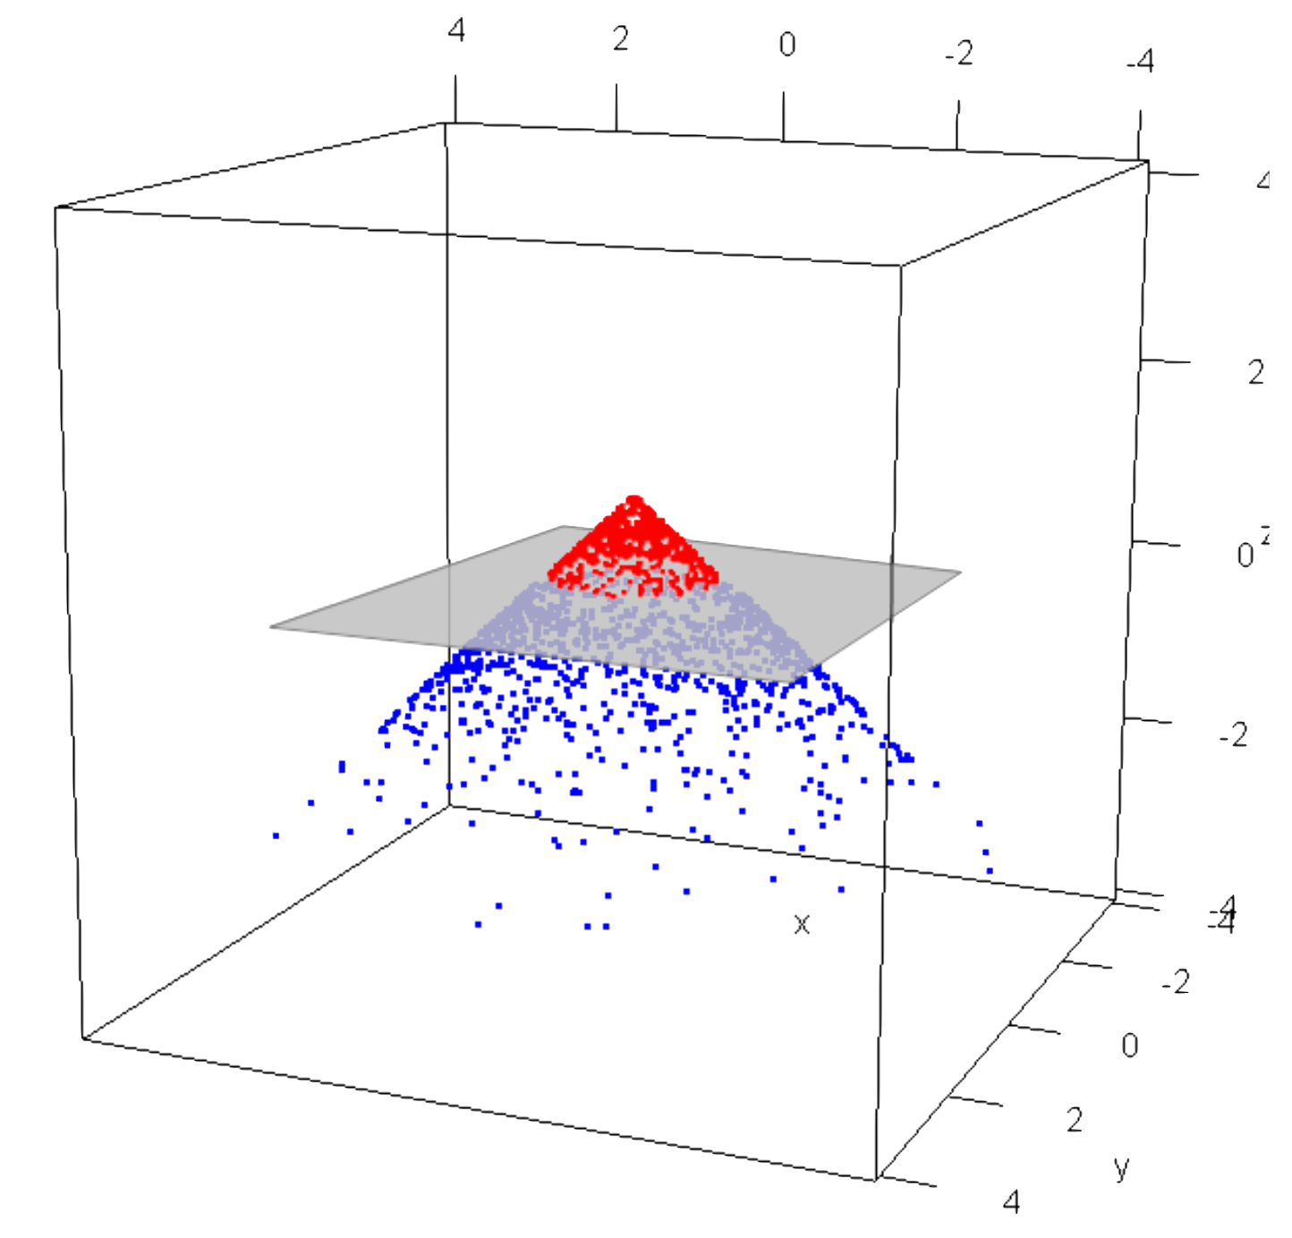
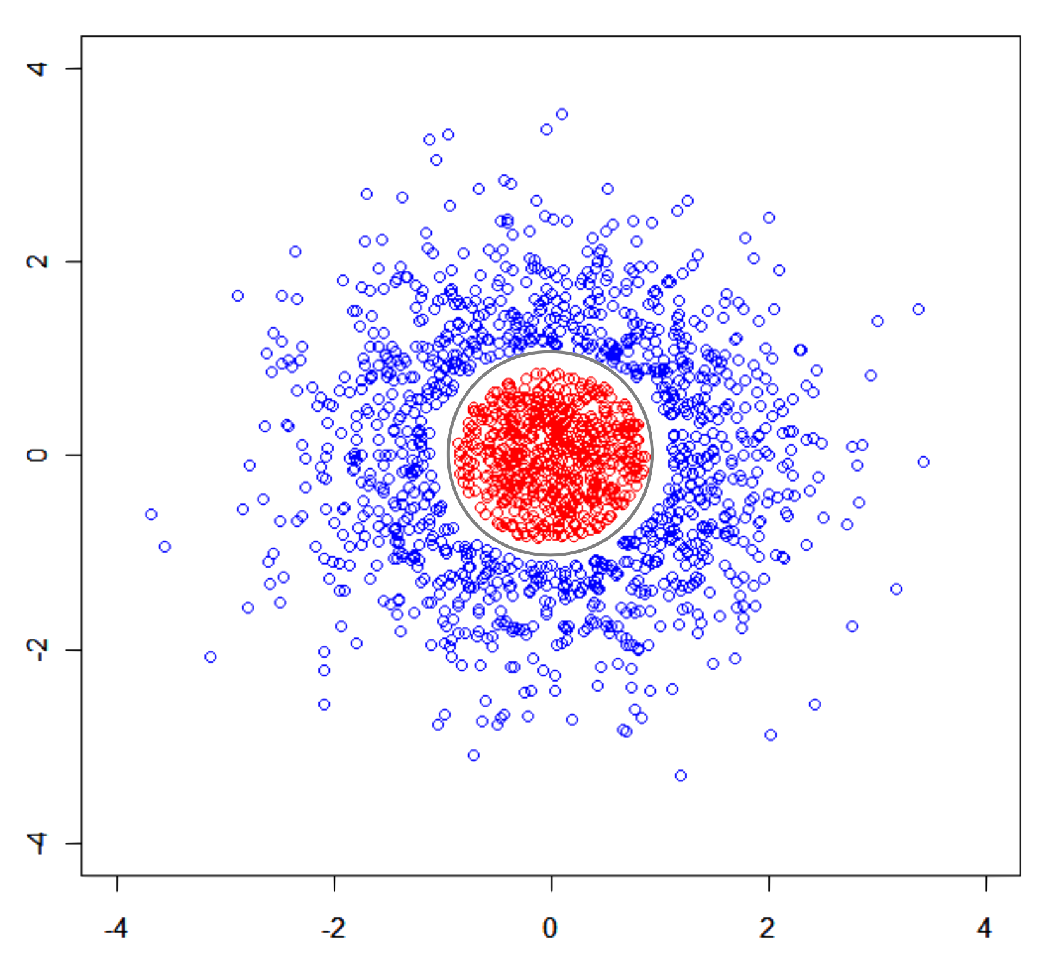
feature
transformation

Slide 31
⟶
𝜙(x₁)
⟶
𝜙(x₂)
⟶
⟶
k(x_{i},x_{j})
⟶
=
𝜙(x₁)
𝜙(X)
𝜙(X)^{T} =
...
⟶
𝜙(x₂)
...
⟶
𝜙(x_{n})
K
⟶
𝜙(x_{n})

Slide 32


